Slide 1
4. Supervised Learning (III)
IT 348/448

Slide 2
Supervised Learning
Given training set of N examples of y = f(x)
(x₁,y₁), (x₂,y₂), (x₃,y₃), …, (x_{N},y_{N})
Find hypothesis (or a model) h that approximates f

Slide 3
Overfitting

Slide 4
Supervised learning Process
1.
Training
Data
Classification Method
Classification Model
Test
Data
Accuracy
2.
Classification Model
New
Data
Classification Model
Class
3.

Slide 5
Supervised Learning
Naïve Bayes Classifier
Decision Tree
SVM

Slide 6
Decision tree

Slide 7
Decision Trees
Classifiers for instances represented as feature vectors
Internal nodes test features with one subtree for each value of the feature

Slide 8
Example: Decision Trees
Problem: decide whether to wait for a table at a restaurant, based on the following attributes:
Alternate: is there an alternative restaurant nearby?
Bar: is there a comfortable bar area to wait in?
Fri/Sat: is today Friday or Saturday?
Hungry: are we hungry?
Patrons: number of people in the restaurant (None, Some, Full)
Price: price range ($, $$, $$$)
Raining: is it raining outside?
Reservation: have we made a reservation?
Type: kind of restaurant (French, Italian, Thai, Burger)
WaitEstimate: estimated waiting time (0-10, 10-30, 30-60, >60)

Slide 9
Attribute-based representations
Examples described by attribute values (Boolean, discrete, continuous)
Ex: classification of examples where I will/won't wait for a table:

Slide 10
Decision trees
One possible representation for hypotheses
We imagine someone talking a sequence of decisions.
Ex: the “true” tree for deciding whether to wait:

Slide 11
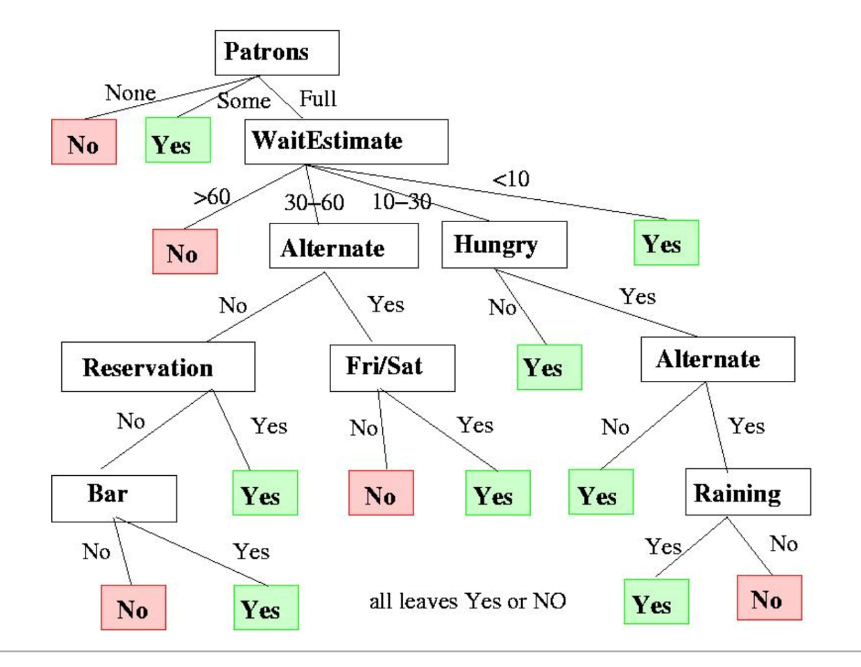
Example: Decision Tree

Slide 12
Decision Tree Algorithms
The basic idea behind any decision tree algorithm is as follows:
Choose the best attribute(s) to split the remaining instances and make that attribute a decision node
Repeat this process for recursively for each child
Stop when:
All the instances have the same target attribute value
There are no more attributes
There are no more instances

Slide 13
ID3 Heuristic
To determine the best attribute, we look at the ID3 heuristic
ID3 splits attributes based on their entropy.
Entropy is the measure of disinformation…

Slide 14
Attribute Selection Criteria
Main principle
Select attribute which partitions the learning set into subsets as “pure” as possible

Slide 15
Entropy
Entropy is minimized
when all values of the target attribute are the same.
Entropy is maximized
when there is an equal chance of all values for the target attribute
(i.e., the result is random) - chaos

Slide 16
Measuring Information Content … 1
Information theory
Provides a formula for determining the number of bits required in an optimal code even when we don't know the code.
Example
In probability terms, each possible value of a six-sided die occurs with equal probability P=1/6.
Information theory tells us that the minimum number of bits required to encode a throw is
- log P = - log 1/6 = 2.58 => 3 bits

Slide 17
Measuring Information Content … 2
Consider how to apply the formula -log P to biased (non-uniform) probability distributions.
Let the variable x range over the values encoded, and let P(x) denote the probability of that value occurring.
The expected number of bits required to encode one value
is the weighted average of the number of bits required to encode each possible value, where the weight is the probability of that value

Slide 18

The Intuition Behind the -P log P Formula
Since the actual distribution we're trying to encode is not uniform,
We take the weighted average of the estimated information content of each value (heads or tails, in the case of a coin), weighted by the probability P of that value occurring.
With the heavily biased coin we have the following:
P(heads) = 1/1000,
so heads takes -log(1/1000) = 9.96578 bits to encode
P(tails) = 999/1000,
so tails takes -log(999/1000) = 0.00144 bits to encode
Average bits required = =
= (1/1000) × 9.96578 + (999/1000) × 0.00144
= 0.01141 bits per coin toss

Slide 19
Measure of Information
Information content of symbol s_{i} :
– log₂p(s_{i})
Examples
p(s_{i}) = 1 has no information
smaller p(s_{i}) has more information, as it was unexpected or surprising
Sun will rise tomorrow morning === 1
Stock goes up tomorrow morning ==== 0.2

Slide 20
Entropy
The expected encoding length measured in bits
The average amount of information needed to classify an object is given by the entropy measure

Slide 21
Entropy
Weigh information content of each source symbol by its probability of occurrence:
Produces lower bound on number of bits needed to represent the information with coding

Slide 22
Example
Alphabet = {A, B}
p(A) = 0.4; p(B) = 0.6
Compute Entropy
(-0.4*log₂ 0.4) + (-0.6*log₂ 0.6) = .97 bits
Maximum uncertainty (gives largest entropy)
occurs when all probabilities are equal
Compute Entropy
(-0.5*log₂ 0.5) + (-0.5*log₂ 0.5) = 1 bit

Slide 23
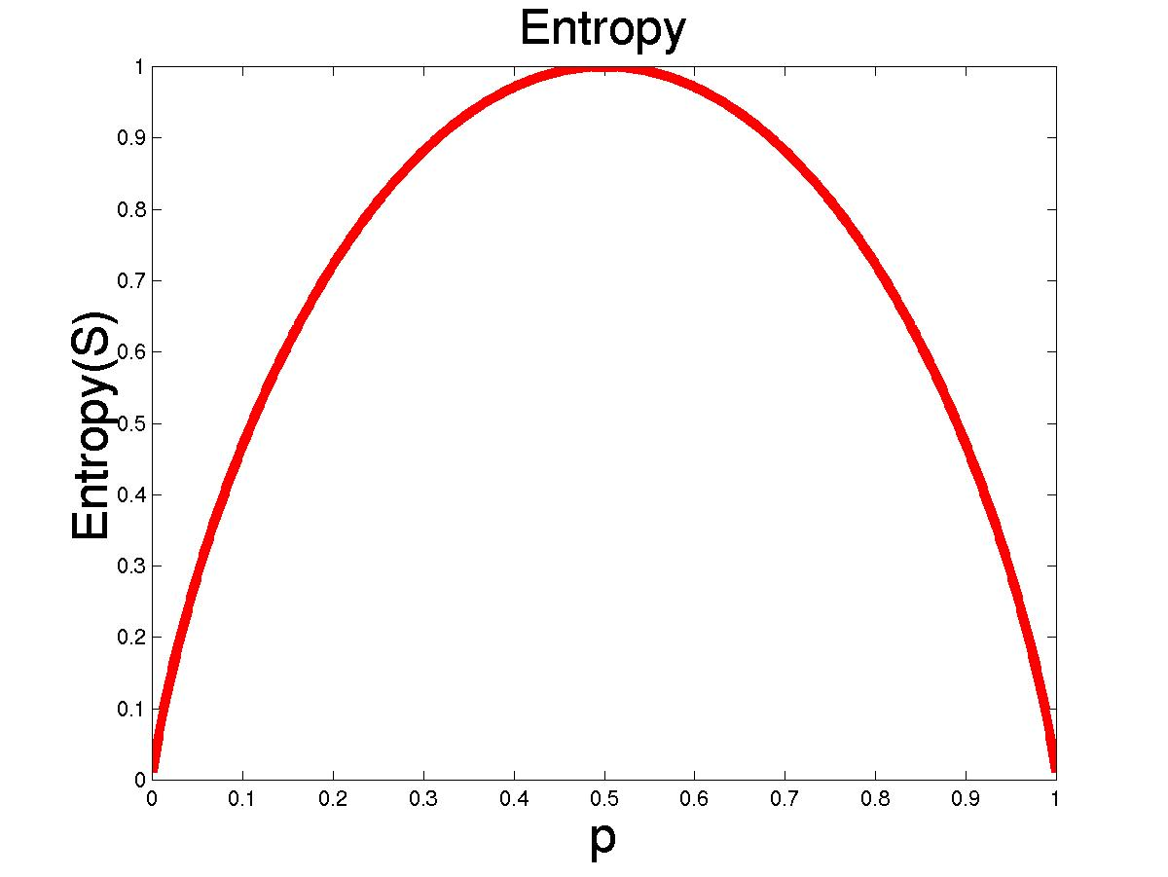
Entropy: Used by ID3
From information theory,
entropy is the number of
bits to encode the class label of an object.
Can be generalized to
Multi-class.
Entropy(S) = - p log₂ p - q log₂ q
Entropy measures the impurity of S
S is a set of examples
p is the proportion of positive examples
q is the proportion of negative examples

Slide 24
Attribute Selection Measure: Information Gain (ID3)
Select the attribute with the highest information gain
Let p_{i} be the probability that an arbitrary tuple (or instance or example) in D belongs to class C_{i}, estimated by |C_{i},_{D}|/|D|
Expected information (entropy) needed to classify a tuple in D:
Where m is the number of classes in target variable
p_{i} is the proportion of the training set that is of class i
D is the training dataset

Slide 25
Attribute Selection Measure: Information Gain (ID3)
Information needed (after using A to split D into v partitions) to classify D:
v is the number of outcomes (or partitions) of a test on A
Information gained by branching on attribute A

Slide 26
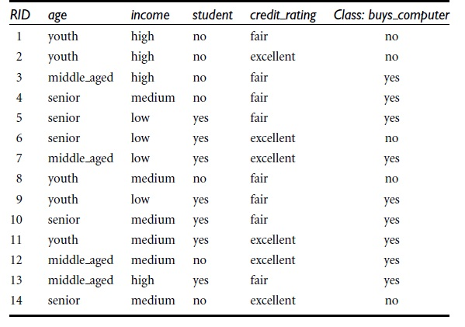
Classification & Prediction
prediction is to predict the “yes” or “no” for a particular new tuple
X = (age = youth, income = medium, student = yes, credit rating = fair)
Buys_computer Table

Slide 27
Attribute Selection
Information Gain and Entropy – from the above Buys_computer table,
Gain(A) = Info(D) – Info_{a} (D)
Info(D) – for the complete table – 9 yes, 5 no, 14 tuples
Info(D) = -9/14 log₂ (9/14) - 5/14 log₂ (5/14) = 0.940 bits
Info_{age} (D) – for the attribute “Age” which has
Youth – total 5 tuples out of 14 tuples, 2 yes and 3 no
Middle aged - total 4 tuples out of 14 tuples, 4 yes and ‘0’ no
Senior - total 5 tuples out of 14 tuples, 3 yes and 2 no
Info_{age} (D) = 5/14 x (-2/5 log₂ 2/5 – 3/5 log₂ 3/5)+
4/14 x (-4/4 log₂ 4/4 – 0/4 log₂ 0/4)+
5/14 x (-3/5 log₂ 3/5 – 2/5 log₂ 2/5)
= 0.694 bits

Slide 28
Attribute Selection
Gain(income) = info(D) – info_{income}(D) = 0.94 – ( ) = 0.029
Gain(student) = info(D) – info_{student}(D) = 0.94 – ( ) = 0.151
Gain(credit_rating) = info(D) – info_{credit_rating}(D) = 0.94 – ( ) = 0.048
Gain(RID) = info(D) – info_{RID}(D) = 0.94 – (0.0 ) = 0.94- overfitting
Similarly, we can compute
Gain(income)=0.029
Gain(student)=0.151
Gain(credit_rating)=0.048
Gain(RID) = 0.94 – 0.0 = 0.94
Since “age” obtains highest information gain, we can partition the tree into:

Slide 29
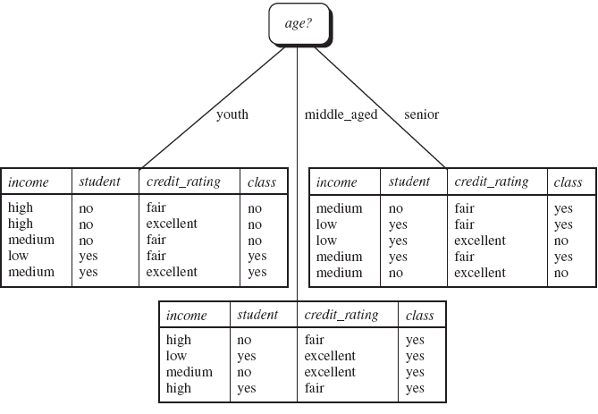
Classification & Prediction
Best Classifier Attribute - Gain is calculated for all the Attributes Age, Income, Student, Credit_rating and the Attribute having Maximum Entropy value will be the Best Classifier Attribute. Entropy(Age) is having the Max value. “Age” is acting as the Best classifier Attribute in the following figure.
Notes:
Infor income

Slide 30
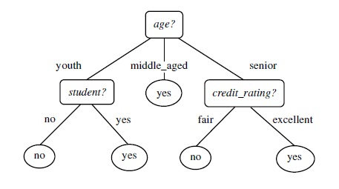
Classification & Prediction
Decision tree classification - Decision tree induction is the learning of decision trees from class-labeled training tuples.
Training data set: Buys_computer
The data set follows an example of Quinlan’s ID3
Resulting tree:
Unseen instance: {Age=senior, student=yes, Income=high, credit_rating=excellent} target class=yes
new instance: {Age=youth, student=yes, Income=high, credit_rating=excellent} target class=??????

Slide 31
Overfitting
Learning a tree that classifies the training data perfectly may not lead to the tree with the best generalization performance since
There may be noise in the training data that the tree is fitting.
The algorithm might be making some decisions toward the leaves of the tree that are based on very little data and may not reflect reliable trends in the data.
A hypothesis, h, is said to overfit the training data
if there exists another hypothesis, h’, such that
h has smaller error than h’ on the training data but
h’ has smaller error on the test data than h.

Slide 32
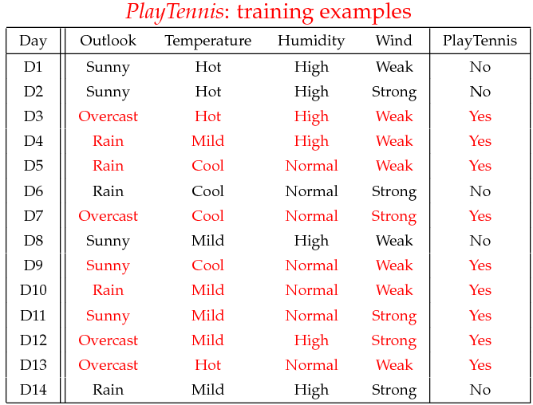
Example
Build a decision tree
Class:
C1: play_tennis = ‘yes’
C2: play_tennis = ‘no’
32

Slide 33
Decision Tree Learning
Day
Outlook
Temperature
Humidity
Wind
PlayTennis
D1
Sunny
Hot
High
Weak
No
D2
Sunny
Hot
High
Strong
No
D3
Overcast
Hot
High
Weak
Yes
D4
Rain
Mild
High
Weak
Yes
D5
Rain
Cool
Normal
Weak
Yes
D6
Rain
Cool
Normal
Strong
No
D7
Overcast
Cool
Normal
Strong
Yes
D8
Sunny
Mild
High
Weak
No
D9
Sunny
Cool
Normal
Weak
Yes
D10
Rain
Mild
Normal
Weak
Yes
D11
Sunny
Mild
Normal
Strong
Yes
D12
Overcast
Mild
High
Strong
Yes
D13
Overcast
Hot
Normal
Weak
Yes
D14
Rain
Mild
High
Strong
No
[See: Tom M. Mitchell, Machine Learning, McGraw-Hill, 1997]

Slide 34
Expected information (entropy) needed to classify a tuple in D:
D: training data
m: the number of classes in target variable
p_{i} : the proportion of the training set that is of class i
E(D) = - p₊ log₂p₊ - p₋ log₂p₋
Info(D) = E(9+,5-) = -(9/14) log₂(9/14) - (5/14) log₂(5/14) = 0.940

Slide 35
PlayTennis: Entropy
Sunny
{D1,D2,D8,D9,D11} [2+, 3-] E=0.970
Outlook?
Overcast
{D3,D7,D12,D13} [4+, 0-] E=0
Rain
{D4,D5,D6,D10,D14} [3+, 2-] E=0.970
High
[3+, 4-] E=0.985
Humidity?
Normal
[6+, 1-] E=0.592
Weak
[6+, 2-] E=0.811
Wind?
Strong
[3+, 3-] E=1.00

Slide 36
Calculate Information needed (after using A to split D into v partitions)
to classify D: (D: current data, A: attribute, and v: the number of values of attribute A)
Here, D=training data; A=outlook; v=3 (i.e., sunny, overcast, and rain)
Sunny
{D1,D2,D8,D9,D11} [2+, 3-] E=0.970
Outlook?
E_{sunny}(2+,3-) = -(2/5) log₂(2/5) - (3/5) log₂(3/5) = 0.9709 = 0.97
Overcast
{D3,D7,D12,D13} [4+, 0-] E=0
E_{overcast}(4+,0-) = -(4/4) log₂(4/4) - (0/4) log₂(0/4) = 0
Rain
{D4,D5,D6,D10,D14} [3+, 2-] E=0.970
E_{rain}(3+,2-) = -(3/5) log₂(3/5) - (2/5) log₂(2/5) = 0.9709 = 0.97
Info_{outlook} =
(5/14) *E_{sunny} + (4/14)* E_{overcast} + (5/14)*E_{rain}
= (5/14)*0.97 + (4/14) * 0 + (5/14)*0.97
= 0.6928 bits

Slide 37
Here, D=training data; A=Humidity; v=2 (i.e., high and normal)
High
[3+, 4-] E=0.985
Humidity?
E_{high}(3+,4-) = -(3/7) log₂(3/7) - (4/7) log₂(4/7) = 0.9852 = 0.985
Normal
[6+, 1-] E=0.592
E_{normal}(6+,1-) = -(6/7) log₂(6/7) - (1/7) log₂(1/7) = 0.5916 = 0.592
Info_{humidity} =
(7/14) *E_{high} + (7/14)* E_{normal}
= (7/14)*0.985 + (7/14) * 0.592
= 0.7885 bits

Slide 38
Here, D=training data; A=Wind; v=2 (i.e., weak and strong)
Weak
[6+, 2-] E=0.811
Wind?
E_{weak}(6+,2-) = -(6/8) log₂(6/8) - (2/8) log₂(2/8) = 0.8112 = 0.811
Strong
[3+, 3-] E=1.00
E_{strong}(3+,3-) = -(3/6) log₂(3/6) - (3/6) log₂(3/6) = 1
Info_{wind} =
(8/14) *E_{weak} + (6/14)* E_{strong}
= (8/14)*0.811 + (6/14) * 1
= 0.892 bits

Slide 39
Calculate information gain
Information gained by branching on attribute A:
Gain(outlook) = info(D) – info_{outlook}(D) = 0.94 – 0.6928 = 0.2472
Gain(humidity) = info(D) – info_{humidity}(D) = 0.94 – 0.7885 = 0.1515
Gain(wind) = info(D) – info_{wind}(D) = 0.94 – 0.892 = 0.048
Choose the attribute that provides highest gain to split the training data in the decision tress.
So we choose the ”outlook” attribute to split the training data.

Slide 40
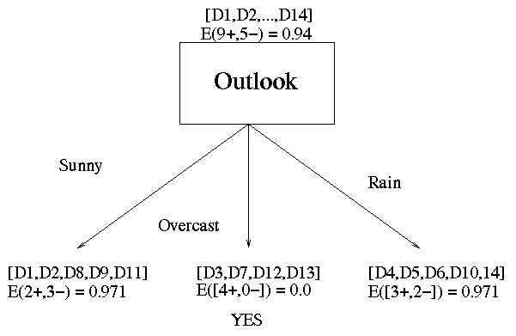
Decision Tree Learning: A Simple Example
Outlook is our winner!

Slide 41


Further splitting data in leaf nodes
We keep splitting the data in leaf nodes until each leaf node has the same type of class or until there is not more data to split.
Currently the leaf nodes by Sunny and Rain still have data in both classes. So we further split these leaf nodes.

Slide 42
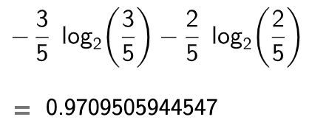

Splitting the leaf node created by the “Rain” attribute
The number of data in this leaf node: 5
Therefore, now our training data set D = 5,
3 yes, and 2 no: [3+, 2-]
Info(D) =

Slide 43

Outlook?
Rain
{D4,D5,D6,D10,D14} [3+, 2-] E=0.970

Slide 44

Now we have three attributes left
Outlook is already used.
Now we have three attributes left:
Humidity, wind, and temperature
We have to calculate information gain for each attribute as we did for the root node in this decision tree.
We will start with “Wind” attribute

Slide 45
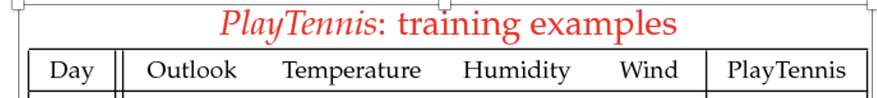
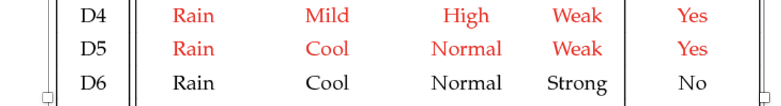
Current leaf node has only five data points (or five training examples): {D4,D5,D6,D10,D14} [3+, 2-] E=0.970
3 yes and 2 no in Play Tennis
45

Slide 46
Current leaf node has only five data points (or five training examples): {D4,D5,D6,D10,D14} [3+, 2-] E=0.970
For wind:
Weak
[3+, 0-] E=0.811
Wind?
E_{weak}(3+,0-) = -(3/3) log₂(3/3) - (0/3) log₂(0/3) = 0
Strong
[0+, 2-] E=1.00
E_{strong}(0+,2-) = -(0/2) log₂(0/2) - (2/2) log₂(2/2) = 0
Info_{wind} =
(3/5) *E_{weak} + (2/5)* E_{strong}
= (3/5)*0 + (3/5) * 0
= 0 bits
46

Slide 47
Since Info_{wind} is zero, the information gain will be largest for “wind” attribute.
Gain(wind) = info(D) - Info_{wind} = 0.97 – 0 = 0.97
This is the highest possible gain among attributes.
Therefore, we do not need to calculate information gain for other attributes.
Then we split the rain node by using the WIND attribute.

Slide 48
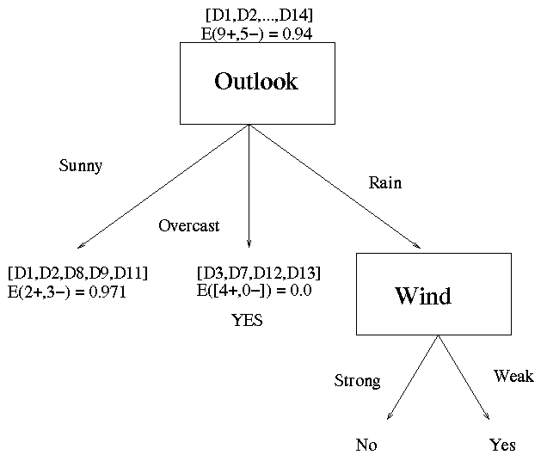
The new Decision Tree
Now our decision tree looks like:

Slide 49

Here the training data in each leaf node belong to a unique class except the leaf node created by Sunny attribute.
So we further split the leaf node created by Sunny attribute.
Now we have a leaf node to split. So the dataset in this leaf node becomes D.
info(D) = E_{sunny}(2+,3-) = -(2/5) log₂(2/5) - (3/5) log₂(3/5) = 0.9709 = 0.97

Slide 50
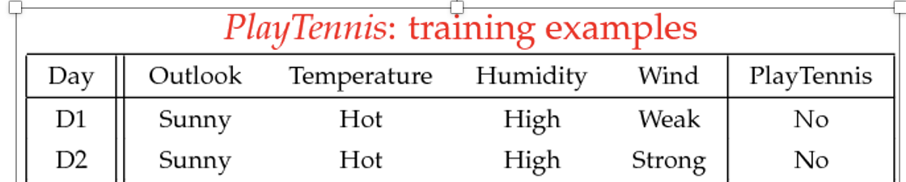
Sunny
{D1,D2,D8,D9,D11} [2+, 3-] E=0.970
Outlook?
E_{sunny}(2+,3-) = -(2/5) log₂(2/5) - (3/5) log₂(3/5) = 0.9709 = 0.97
info(D) = E_{sunny}(2+,3-) = -(2/5) log₂(2/5) - (3/5) log₂(3/5)
= 0.9709 = 0.97
Now our dataset (D) is as follows: 2 yes and 3 no in Play Tennis

Slide 51
now three attributes available: temperature, wind, and humidity
We need to calculate information gain for each of these three attributes.
We will start with humidity

Slide 52
[0+, 3-] E=0.985
High
Humidity?
E_{high}(0+,3-) = -(0/3) log₂(0/3) - (3/3) log₂(3/3) = 0
Normal
[2+, 0-] E=0.592
E_{normal}(2+,0-) = -(2/2) log₂(2/2) - (0/2) log₂(0/2) = 0
Info_{humidity} =
(3/5) *E_{high} + (2/5)* E_{normal}
= (3/5) * 0 + (2/5) * 0
= 0 bits
52

Slide 53
Since Info_{humidity} is zero, the information gain will be largest for “humidity” attribute.
Gain(humidity) = info(D) - Info_{humidity} = 0.97 – 0 = 0.97
This is the highest possible gain among attributes: temperature, wind, and humidity.
Therefore, we do not need to calculate information gain for other attributes.
Then we split the rain node by using the HUMIDITY attribute as shown in the next slide.

Slide 54
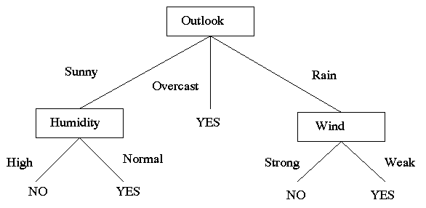
Final Decision Tree
(Outlook = Sunny ∧ Humidity = Normal) ∨ (Outlook = Overcast) ∨ (Outlook = Rain ∧ Wind = Weak)
[See: Tom M. Mitchell, Machine Learning, McGraw-Hill, 1997]

Slide 55
Since all leaf nodes in the final decision tree have instances in the same class (or a unique class), we stop splitting the leaf nodes.
This is the final decision tree.

Slide 56
How to use the decision tree?
Start from the root node.
If outlook=overcast, then play tennis.
If outlook=sunny and humidity=normal, then play tennis.
If outlook=rain and wind=weak, then play tennis.
It can be summarized as follows:

Slide 57
GINI index

Slide 58
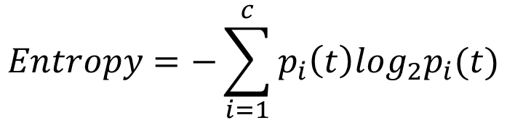
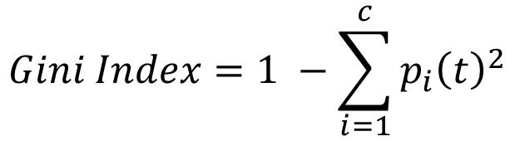
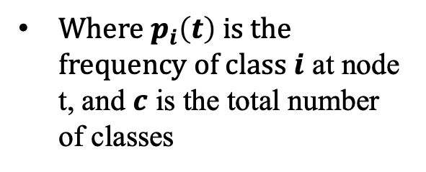
Measures of Node Impurity
Gini Index
Entropy
$$Gini Index=1 −\sum_{i=1}^{c}{p_{i}{\left(t\right)}^{2}}$$
Where $p_{i}\left(t\right)$ is the frequency of class $i$ at node t, and $c$ is the total number of classes
$$Entropy=−\sum_{i=1}^{c}{p_{i}\left(t\right)log_{2}p_{i}(t)}$$

Slide 59
Gini Index (CART, IBM IntelligentMiner)
The Gini index
measures the impurity of D
Considers a binary split for each attribute

Slide 60
Finding the Best Split
Before Splitting:
P
A?
B?
Yes
No
Yes
No
Node N1
Node N2
Node N3
Node N4
M11
M12
M21
M22
M1
M2
Gain = P – M1 vs P – M2

Slide 61
Gini Index (CART, IBM IntelligentMiner)
If a data set D contains examples from n classes, Gini index, Gini(D) is defined as
where p(j) is the relative frequency of class j in D
If a data set D is split on A into two subsets D₁ and D₂, the Gini index Gini(D) is defined as
Reduction in Impurity:
The attribute provides the smallest Gini_{split}(D) (or the largest reduction in impurity) is chosen to split the node (need to enumerate all the possible splitting points for each attribute)

Slide 62
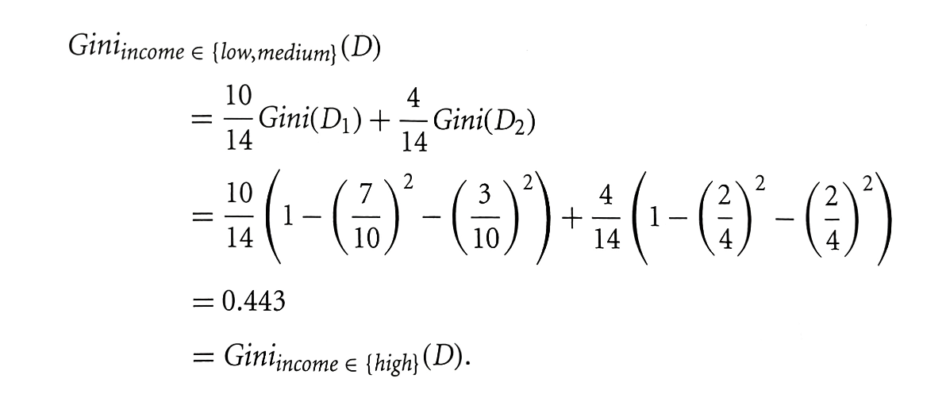
Computation of Gini Index
Example: D has 9 tuples in buys_computer = “yes” and 5 in “no”
Suppose the attribute income partitions D into
10 in D₁ : {low, medium}
4 in D₂ : {high}
Gini_{income} = 0.458 for the subsets {low, high} and {medium}
Gini_{income} = 0.450 for the subsets {medium, high} and {low}
Thus the best split for attribute ”Income” is on {low, medium} and {high} since this split minimizes the Gini index and maximizes reduction in impurity.

Slide 63
Measure of Impurity: GINI
Gini Index for a given node t :
(NOTE: p( j ) is the relative frequency of class j at node t).
Maximum (1 - 1/n_{c}) when records are equally distributed among all classes, implying least interesting information (where n_{c} is the number of classes)
Minimum (0.0) when all records belong to one class, implying most interesting information

Slide 64
Examples for computing GINI
P(C1) = 0/6 = 0 P(C2) = 6/6 = 1
Gini = 1 – P(C1)² – P(C2)² = 1 – 0 – 1 = 0
P(C1) = 1/6 P(C2) = 5/6
Gini = 1 – (1/6)² – (5/6)² = 0.278
P(C1) = 2/6 P(C2) = 4/6
Gini = 1 – (2/6)² – (4/6)² = 0.444

Slide 65
Splitting Based on GINI
Used in CART, SLIQ, SPRINT.
When a node p is split into k partitions (children), the quality of split is computed as,
where, n_{i} = number of records at child i,
n = number of records at node p.

Slide 66
Binary Attributes: Computing GINI Index
Splits into two partitions
Effect of Weighing partitions:
Larger and Purer Partitions are sought for.
B?
Yes
No
Node N1
Node N2
Gini(N1) = 1 – (5/7)² – (2/7)² = 0.40816
Gini(N2) = 1 – (1/5)² – (4/5)² = 0.32
Gini(Children) = 7/12 * 0.408 + 5/12 * 0.32 = .371

Slide 67
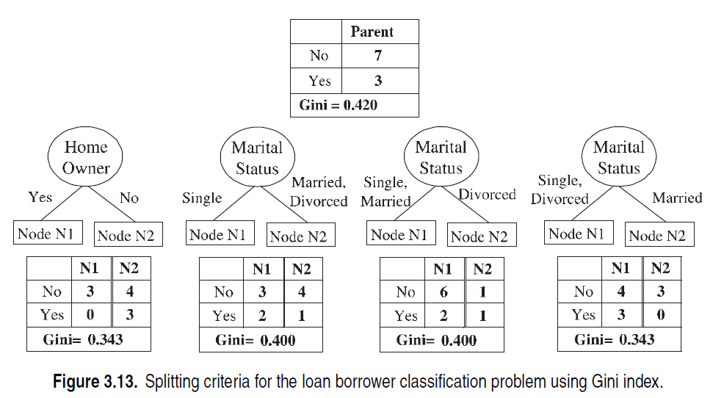
Examples

Slide 68
Continuous Attributes: Computing Gini Index
Use Binary Decisions based on one value
Several Choices for the splitting value
Number of possible splitting values = Number of distinct values
Each splitting value has a count matrix associated with it
Class counts in each of the partitions, A < v and A ≥ v
Simple method to choose best v
For each v, scan the database to gather count matrix and compute its Gini index
Computationally Inefficient! Repetition of work.

Slide 69
Continuous Attributes: Computing Gini Index...
For efficient computation: for each attribute,
Sort the attribute on values
Linearly scan these values, each time updating the count matrix and computing gini index
Choose the split position that has the least gini index
Sorted Values
Split Positions

Slide 70
Further optimization
The best split position corresponds to the one with the smallest Gini index (0.300)
Its split position is 97
Further optimization
Considers only candidate split positions located between two adjacent records with different class labels
Ignores the candidate split positions at 55K, 65K, 72K, 87K, 92K, 110K, 122K, 172K, 230K
Allows to reduce the number of candidate split positions from 11 to 2

Slide 71
Summary Comparing Attribute Selection Measures
The two measures, in general, return good results but
Information gain:
biased towards multivalued attributes
Gini index:
has difficulty when # of classes is large
tends to favor tests that result in equal-sized partitions and purity in both partitions

Slide 72
Overfitting & pruning

Slide 73
Example
Outlook = Sunny,
Temp = Hot
Humidity = Normal
Wind = Strong
label: NO
this example doesn’t exist in the tree
Outlook
Sunny
Overcast
Rain
1,2,8,9,11
4,5,6,10,14
2+,3-
3,7,12,13
3+,2-
4+,0-
Wind
Humidity
Yes
Normal
Strong
Weak
High
No
Yes
No
Yes

Slide 74
Overfitting - Example
Outlook = Sunny,
Temp = Hot
Humidity = Normal
Wind = Strong
label: NO
this example doesn’t exist in the tree
Outlook
Sunny
Overcast
Rain
1,2,8,9,11
3,7,12,13
4,5,6,10,14
2+,3-
4+,0-
3+,2-
Humidity
Yes
Wind
This can always be done – may fit noise or other coincidental regularities
High
Normal
Strong
Weak
74
No
Wind
No
Yes
Strong
Weak
No
Yes

Slide 75
Overfitting the Data
Learning a tree that classifies the training data perfectly may not lead to the tree with the best generalization performance.
There may be noise in the training data the tree is fitting
The algorithm might be making decisions based on very little data

Slide 76
Reasons for Overfitting
Too much variance in the training data
Training data is not a representative sample of the instance space
We split on features that are actually irrelevant
Too much noise in the training data
Noise = some feature values or class labels are incorrect
We learn to predict the noise
In both cases, it is a result of our will to minimize the empirical error when we learn, and the ability to do it (with DTs)

Slide 77
Pruning a decision tree
Prune
remove leaves and assign majority label of the parent to all items
Prune the children of node s if:
all children are leaves, and
the accuracy on the validation set does not decrease if we assign the most frequent class label to all items at s.

Slide 78
Avoiding Overfitting
Two basic approaches
Pre-pruning: Stop growing the tree at some point during construction when it is determined that there is not enough data to make reliable choices.
Post-pruning: Grow the full tree and then remove nodes that seem not to have sufficient evidence.
Methods for evaluating subtrees to prune
Cross-validation: Reserve hold-out set to evaluate utility
Statistical testing: Test if the observed regularity can be dismissed as likely to occur by chance
The goal is to guarantee/improve generalization
This is related to the notion of regularization that we will see in other contexts – keep the hypothesis simple.

